Slide 1

ReserveRec
Zack Withers, Ryan Carrigan, Bryant Conquest, Philip Speegle

Slide 2
What is ReserveRec?
Play any sport, any time
Custom feed where you can join or create events
Custom profiles and display statistics

Slide 3
Major Sprint Goals
Learn Dart and Begin Research
Allow Users to Sign In
Hash Passwords and Store Them Securely
Create and Populate Feed
Find a User’s Location
Create New Users and Posts
Create Logo
10 hours ✓
3 hours ✓
2 hours ✓
10 hours ✓
3 hours ✓
5 hours ✓
2 hours ✓
Overarching Theme: Lay the Foundation for the App

Slide 4
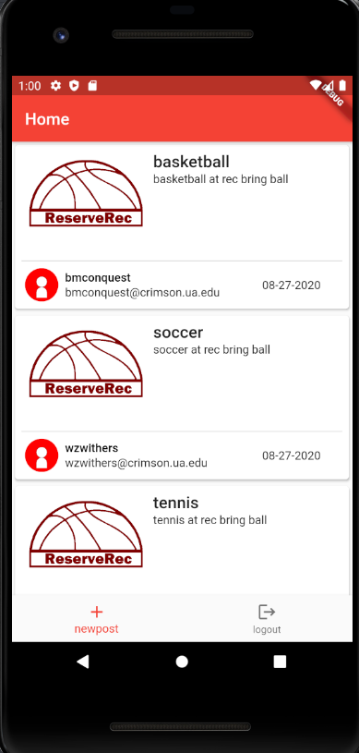
The Feed
Shows title of sport and description of the activity the user desires
Currently can only add posts and view the existing posts
Future goals
Notes:
We created a scrollable, interactive feed which updates in real-time. This shows the title, description, and the date of each event. Currently, you only have the ability to add posts and view existing ones. However, these posts are persistent due to our current backend setup. What we will add in the next sprint is the ability to join posts and view more detailed information. Additionally, we will implement the ability to filter the post based off of sport, time or availability. So stay tuned for our future updates.

Slide 5
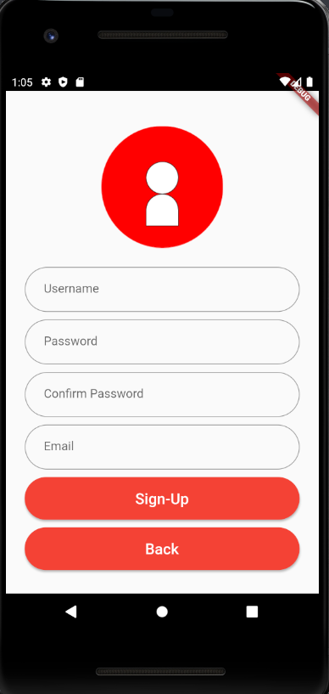
The User Sign Up
Takes user information and adds them to the existing users
Future goals
Notes:
We currently have a setup for any user to signup. The primary key for a user is its user ID, and upon signing up, the function auto generates user IDs and sets default email verification to false. This user will be persistent. In the future, we will be adding user types for players and rec managers (you know how some sites have a “Are you a manager? Use this form” link)

Slide 6
Achievements
Created a scrollable, interactive feed which updates in real-time
Successfully integrated with location services
Passwords secured using SHA256 hashing function
SHA256("The quick brown fox jumps over the lazy dog")
0x730e109bd7a8a32b1cb9d9a09aa2325d2430587ddbc0c38bad911525
SHA256("The quick brown fox jumps over the lazy dog.")
0x619cba8e8e05826e9b8c519c0a5c68f4fb653e8a3d8aa04bb2c8cd4c
Notes:
For our achievements, we separate them into three groups: interaction, integration, and security. Our biggest accomplishment for the former was creating the feed that allows users to create and see sports. We have integrated with location ser

Slide 7
Challenges
Dart and Flutter tightly coupled
SQL integration much more difficult than anticipated
Dart being inherently asynchronous provided a lot of trouble
Ambiguous division of work made it unclear who was doing what and what each task/story was supposed to do
Notes:
The constant coupling of Dart and Flutter made differentiating the two somewhat difficult. Many times, troubleshooting was a bit tricky because whether the issue was with Dart or Flutter was sometimes ambiguous. Similarly, SQL integration has proven to be much more difficult than anticipated. In particular, there is very little information on how to connect to a MS SQL Server database using Flutter and there is not much Sqlite Flutter documentation. Even though we have persistence with the update of local files, storing the data locally is only a short-term solution.

Slide 8
Future Plans
Complete integration with a backend web server
User profiles and statistics
Add more functionality to new posts
Better time input
Display an Individual Post
More detailed information about current posts
Able to join or mark posts as interested
Separate UI and login for rec centers
Start working on unit testing

Slide 9
Live Demo

Slide 10
Thank you
Zack Withers: wzwithers@crimson.ua.edu
Ryan Carrigan: rpcarrigan@crimson.ua.edu
Bryant Conquest: bmconquest@crimson.ua.edu
Philip Speegle: pspeegle@crimson.ua.edu

